Slide 1
Dependency Analysis for Kactus2
Final Presentation

Slide 2
Outline
Project Organization
Project Background & Objectives
What was done?
Problems Met and Solutions
Realized Risks
Time Usage
What did we learn?
Conclusion

Slide 3
Project Organization
Project team
Joni-Matti Määttä (project manager, SW architect, developer)
Mikko Honkonen (test lead, developer)
Tommi Korhonen (UI specialist, developer)
Client
Timo D. Hämäläinen
Course staff
Marko Hännikäinen
Francescantonio Della Rosa

Slide 4
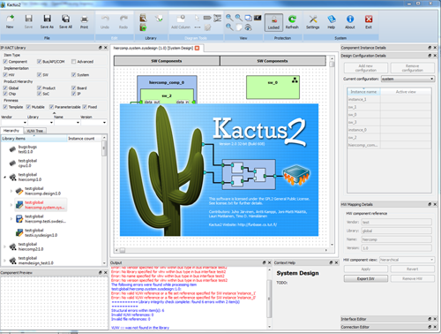
Project Background (1)
Kactus2
Developed at TUT
Open-source toolset to design embedded products, especially FPGA-based MP-SoCs
Based on IP-XACT XML metadata and design methodology
Kactus2 goals
Easier IP reusability
Practical HW/SW abstraction for easier application SW development
The most user-friendly EDA tool

Slide 5
Project Background (2)
Compilation errors are often caused by missing dependent files or libraries
As project size increases, it becomes more and more difficult to keep track of these file dependencies
Solution: automate file dependency tracking by scanning supported files and keeping track of file changes
Allow also manual dependencies between e.g. source code and documentation
VHDL
Dependency
Analysis
Tool
C++
C++
file1
file2
file3
file4
file5

Slide 6
Objectives
Objectives of the project group
Finish a whole software development project in schedule and learn about project management and scheduling
Have a working first version integrated into Kactus2
Objectives of the client
Tool should offer features that make the use of Kactus2 easier (requires user study)
Tool should be well integrated into Kactus2

Slide 7
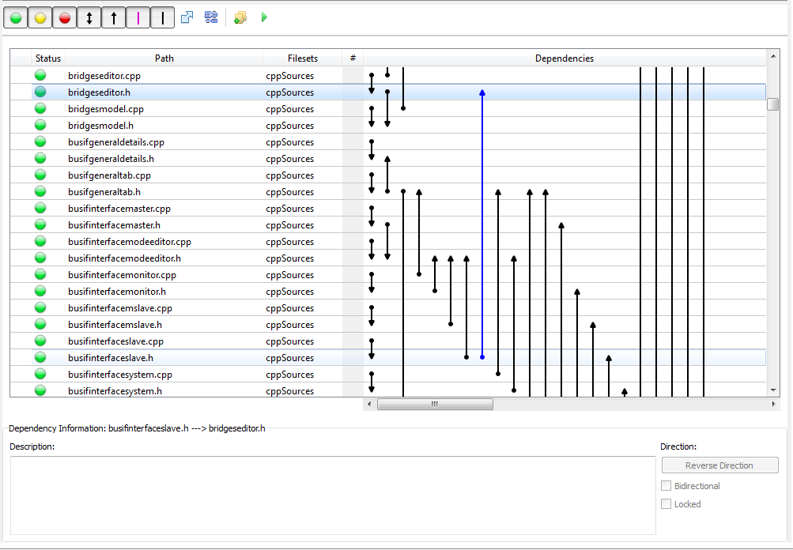
What was done? (1)

Slide 8
What was done? (2)
Source code parsing and dependency analysis
C/C++ and VHDL supported
Ability to create manual dependencies
E.g. between documentation and source files
Dependency visualization in a table-graph format, including
Changes detection
File hash calculation
Dependency difference view
Filtering
All this represented with a clean, simple UI
Fully integrated into Kactus2

Slide 9
Problems Met and Solutions
Not always enough time to work for the project
Was compensated by team efficiency and careful implementation
Tasks required less time than expected
It was possible to reuse more features from Qt than was assumed

Slide 10
Realized Risks
Sickness
Caused one week delay which was compensated later on
Development server downtime
Sourceforge (version control) was temporarily down
Hostedredmine.com (project management) was down
No severe effects

Slide 11
Time Usage

Slide 12
Time Usage

Slide 13
What did we learn?
Scheduling is difficult
Especially when using libraries you don’t know inside out
It is better to overestimate than to underestimate
Although overestimation is not good either
Don’t reinvent the wheel
30 minutes of research can save hours of work
Reimplementing an algorithm in a different language is much simpler than figuring it out
In this project: saved over 80 hours of work
Not all projects are full of problems

Slide 14
Conclusion
The project was successful
The first fully functional version of the tool was finished
All members are now familiar with Qt development
Next steps after the project
User study to make sure the usability of the tool is good
Several potential improvements were invented → review and implementation to the next version

Slide 15
Demo

Slide 16
Questions?

